Slide 1
Centrality in Networks

Slide 2
Levels of Analysis in social networks
Individual
1
Dyads
2
Triads
3
Cliques, Communities
4
Whole Network
5
The first part of the course follows this organization!

Slide 3
Levels of Analysis in social networks
Centrality
Individual
1
Dyads
2
Triads
3
Cliques, Communities
4
Whole Network
5
The first part of the course follows this organization!

Slide 4
Centrality: What is it?
A measure of the importance or strategic location of a node in the network:
  Autonomy
  Control
  Risk
  Exposure
  Influence
  Belongingness
  Brokerage
  Independence
  Power
s
e
q
b
g
p
m
d
l
a
h
i
j
k
f
n
o
c
r

Slide 5
Centrality: What is it?
A centrality metric is a summary index of the centrality of a node
  Based on sums or averages of one of three things:
s
q
p
m
l
i
j
k
n
o

Slide 6
Centrality: What is it?
A centrality metric is a summary index of the centrality of a node
  Based on sums or averages of one of three things:
    Number of edges that are directly incident upon that node.
e
b
g
d
a
h
f
c
r

Slide 7
Centrality: What is it?
A centrality metric is a summary index of the centrality of a node
  Based on sums or averages of one of three things:
    Number of edges that are directly incident upon that node.
    The length of the shortest paths (smaller is better) having that node as one of their ends
e
b
g
d
a
h
f
c
r

Slide 8
Centrality: What is it?
A centrality metric is a summary index of the centrality of a node
  Based on sums or averages of one of three things:
    Number of edges that are directly incident upon that node.
    The length of the shortest paths (smaller is better) having that node as one of their ends
    The proportion of the shortest paths that have that node as one of their inner nodes
e
b
g
d
a
h
f
c
r

Slide 9
Centrality: What is it?
A centrality metric is a summary index of the centrality of a node
  Based on sums or averages of one of three things:
    Number of edges that are directly incident upon that node.
    The length of the shortest paths (smaller is better) having that node as one of their ends
    The proportion of the shortest paths that have that node as one of their inner nodes
The more/more principle:
  The more a node has of these things the more central it is!
p
m
l
i
j
k
n
o

Slide 10
Centrality: What is it?
A centrality metric is a summary index of the centrality of a node
  Based on sums or averages of one of three things:
    Number of edges that are directly incident upon that node.
    The length of the shortest paths (smaller is better) having that node as one of their ends
    The proportion of the shortest paths that have that node as one of their inner nodes
Result is a ranking of all nodes
  From most central (top) to least central (bottom)
j
k
m
p
i
n
o
l
p
m
l
i
j
k
n
o

Slide 11

Degree C_{d}(v_{i})
Simplest (local) centrality measure to compute
Graph theory definition:
  Number of edges incident to a node
  Cardinality of the set of neighbors of a node
In undirected graphs:
  Given by either row or column sum vector of corresponding adjacency matrix
Undirected Graph
 | a | b | c | d | e
a | -- | 1 | 0 | 0 | 0
b | 1 | -- | 1 | 0 | 0
c | 0 | 1 | -- | 1 | 1
d | 0 | 0 | 1 | -- | 1
e | 0 | 0 | 1 | 1 | --

Slide 12
Degree C_{d}(v_{i})
Simplest (local) centrality measure to compute
Graph theory definition:
  Number of edges incident to a node
  Cardinality of the set of neighbors of a node
In undirected graphs:
  Given by either row or column sum vector of corresponding adjacency matrix
Undirected Graph
 | a | b | c | d | e
a | -- | 1 | 0 | 0 | 0
b | 1 | -- | 1 | 0 | 0
c | 0 | 1 | -- | 1 | 1
d | 0 | 0 | 1 | -- | 1
e | 0 | 0 | 1 | 1 | --
1
2
3
2
2

Slide 13
Degree C_{d}(v_{i}): Undirected
Simplest (local) centrality measure to compute
Graph theory definition:
  Number of edges incident to a node
  Cardinality of the set of neighbors of a node
In undirected graphs:
  Given by either row or column sum vector of corresponding adjacency matrix
Undirected Graph
 | a | b | c | d | e
a | -- | 1 | 0 | 0 | 0
b | 1 | -- | 1 | 0 | 0
c | 0 | 1 | -- | 1 | 1
d | 0 | 0 | 1 | -- | 1
e | 0 | 0 | 1 | 1 | --
1
2
3
2
2
1 | 2 | 3 | 2 | 2

Slide 14
Degree C_{d}(v_{i}): Undirected
Simplest (local) centrality measure to compute
Graph theory definition:
  Number of edges incident to a node
  Cardinality of the set of neighbors of a node
In undirected graphs:
  Given by either row or column sum vector of corresponding adjacency matrix
Undirected Graph
 | a | b | c | d | e
a | -- | 1 | 0 | 0 | 0
b | 1 | -- | 1 | 0 | 0
c | 0 | 1 | -- | 1 | 1
d | 0 | 0 | 1 | -- | 1
e | 0 | 0 | 1 | 1 | --
1
2
3
2
2
1 | 2 | 3 | 2 | 2

Slide 15
Degree C_{d}(v_{i}): Undirected
Simplest (local) centrality measure to compute
Graph theory definition:
  Number of edges incident to a node
  Cardinality of the set of neighbors of a node
In undirected graphs:
  Given by either row or column sum vector of corresponding adjacency matrix
Undirected Graph
 | a | b | c | d | e
a | -- | 1 | 0 | 0 | 0
b | 1 | -- | 1 | 0 | 0
c | 0 | 1 | -- | 1 | 1
d | 0 | 0 | 1 | -- | 1
e | 0 | 0 | 1 | 1 | --
1
2
3
2
2
1 | 2 | 3 | 2 | 2

Slide 16
Node neighborhoods in directed graphs
In undirected graphs nodes have a single set of neighbors
C
B
E
A
D

Slide 17
Node neighborhoods in directed graphs
In undirected graphs nodes have a single set of neighbors
  N(E) = {B, C, D}
C
B
E
A
D

Slide 18
Node neighborhoods in directed graphs
In directed graphs nodes have two separate set of neighbors:
  Out-neighbors
  In-neighbors
C
B
E
A
D

Slide 19
Node neighborhoods in directed graphs
In directed graphs nodes have two separate set of neighbors:
  Out-neighbors
  In-neighbors
Out-neighbors of E:
  Set of nodes incident to arcs that have E as the source node
    N_{out}(E) = {B, D}
C
B
E
A
D

Slide 20
Node neighborhoods in directed graphs
In directed graphs nodes have two separate set of neighbors:
  Out-neighbors
  In-neighbors
Out-neighbors of E:
  Set of nodes incident to arcs that have E as the source node
    N_{out}(E) = {B, D}
In-neighbors of E:
  Set of nodes incident to arcs that have E as the destination node
    N_{In}(E) = {B, D, C}
C
B
E
A
D

Slide 21

Degree C_{deg}(v): Directed
In directed graphs nodes have two separate types of degree centrality:
  Outdegree centrality
  Indegree centrality
Graph theory definition:
  Outdegree:
    Cardinality of the set of out-neighbors
  Indegree:
    Cardinality of the set of in-neighbors
Directed Graph
 | a | b | c | d | e
a | -- | 1 | 0 | 0 | 0
b | 1 | -- | 0 | 0 | 0
c | 0 | 1 | -- | 1 | 1
d | 0 | 0 | 0 | -- | 0
e | 0 | 0 | 1 | 1 | --

Slide 22
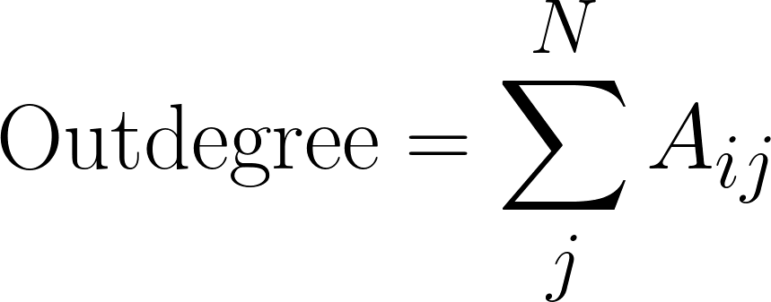
Degree C_{deg}(v): Directed
In directed graphs nodes have two separate types of degree centrality:
  Outdegree centrality
  Indegree centrality
Graph theory definition:
  Outdegree:
    Cardinality of the set of out-neighbors
  Indegree:
    Cardinality of the set of in-neighbors
Outdegree calculated by summing the rows of the asymmetric adjacency matrix
Directed Graph
 | a | b | c | d | e
a | -- | 1 | 0 | 0 | 0
b | 1 | -- | 0 | 0 | 0
c | 0 | 1 | -- | 1 | 1
d | 0 | 0 | 0 | -- | 0
e | 0 | 0 | 1 | 1 | --

Slide 23
Degree C_{deg}(v): Directed
In directed graphs nodes have two separate types of degree centrality:
  Outdegree centrality
  Indegree centrality
Graph theory definition:
  Outdegree:
    Cardinality of the set of out-neighbors
  Indegree:
    Cardinality of the set of in-neighbors
Outdegree calculated by summing the rows of the asymmetric adjacency matrix
Directed Graph
 | a | b | c | d | e
a | -- | 1 | 0 | 0 | 0
b | 1 | -- | 0 | 0 | 0
c | 0 | 1 | -- | 1 | 1
d | 0 | 0 | 0 | -- | 0
e | 0 | 0 | 1 | 1 | --
1
1
3
0
2

Slide 24
Degree C_{deg}(v): Directed
In directed graphs nodes have two separate types of degree centrality:
  Outdegree centrality
  Indegree centrality
Graph theory definition:
  Outdegree:
    Cardinality of the set of out-neighbors
  Indegree:
    Cardinality of the set of in-neighbors
Outdegree calculated by summing the rows of the asymmetric adjacency matrix
Directed Graph
 | a | b | c | d | e
a | -- | 1 | 0 | 0 | 0
b | 1 | -- | 0 | 0 | 0
c | 0 | 1 | -- | 1 | 1
d | 0 | 0 | 0 | -- | 0
e | 0 | 0 | 1 | 1 | --
1
1
3
0
2

Slide 25
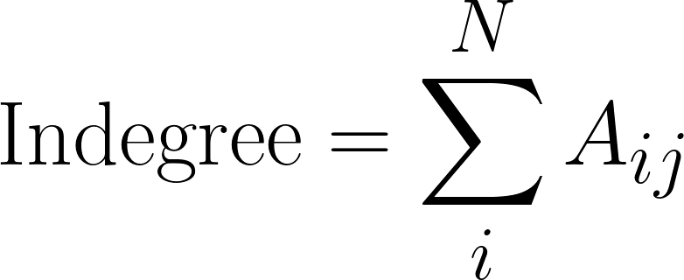
Degree C_{deg}(v): Directed
In directed graphs nodes have two separate types of degree centrality:
  Outdegree centrality
  Indegree centrality
Graph theory definition:
  Outdegree:
    Cardinality of the set of out-neighbors
  Indegree:
    Cardinality of the set of in-neighbors
Indegree calculated by summing the columns of the asymmetric adjacency matrix
Directed Graph
 | a | b | c | d | e
a | -- | 1 | 0 | 0 | 0
b | 1 | -- | 0 | 0 | 0
c | 0 | 1 | -- | 1 | 1
d | 0 | 0 | 0 | -- | 0
e | 0 | 0 | 1 | 1 | --

Slide 26
Degree C_{deg}(v): Directed
In directed graphs nodes have two separate types of degree centrality:
  Outdegree centrality
  Indegree centrality
Graph theory definition:
  Outdegree:
    Cardinality of the set of out-neighbors
  Indegree:
    Cardinality of the set of in-neighbors
Indegree calculated by summing the columns of the asymmetric adjacency matrix
Directed Graph
 | a | b | c | d | e
a | -- | 1 | 0 | 0 | 0
b | 1 | -- | 0 | 0 | 0
c | 0 | 1 | -- | 1 | 1
d | 0 | 0 | 0 | -- | 0
e | 0 | 0 | 1 | 1 | --
1 | 2 | 1 | 2 | 1

Slide 27
Degree C_{deg}(v)
In directed graphs nodes have two separate types of degree centrality:
  Outdegree centrality
  Indegree centrality
Graph theory definition:
  Outdegree:
    Cardinality of the set of out-neighbors
  Indegree:
    Cardinality of the set of in-neighbors
Indegree calculated by summing the columns of the asymmetric adjacency matrix
Directed Graph
 | a | b | c | d | e
a | -- | 1 | 0 | 0 | 0
b | 1 | -- | 0 | 0 | 0
c | 0 | 1 | -- | 1 | 1
d | 0 | 0 | 0 | -- | 0
e | 0 | 0 | 1 | 1 | --
1 | 2 | 1 | 2 | 1

Slide 28
Centrality Beyond Degree
s
e
q
b
g
p
m
d
l
a
h
i
j
f
k
n
o
c
r

Slide 29
a | b | c | d | e | f | g | h | i | j | k | l | m | n | o | p | q | r | s
3 | 4 | 2 | 5 | 3 | 4 | 5 | 4 | 4 | 7 | 3 | 3 | 3 | 3 | 2 | 3 | 2 | 1 | 1
In this graph this node has the largest degree centrality!
s
e
q
b
g
p
m
d
l
a
h
i
j
f
k
n
o
c
r

Slide 30
Centrality Beyond Degree
s
e
q
b
g
p
m
d
l
a
h
i
j
f
k
n
C_{Deg}(j) = 7
o
c
r

Slide 31
Centrality Beyond Degree: Closeness (C_{Clos})
s
e
q
b
g
p
m
d
l
a
h
i
j
f
k
n
o
c
r

Slide 32
Centrality Beyond Degree: Closeness (C_{Clos})
A node that can reach all the other nodes in the graph via the shortest paths (on average) has the largest closeness centrality!
s
e
q
b
g
p
m
d
l
a
h
i
j
f
k
n
o
c
r

Slide 33
Centrality Beyond Degree: Closeness (C_{Clos})
In this graph, this node has the largest closeness centrality!
s
e
q
b
g
p
m
d
l
a
h
i
j
f
k
n
o
c
r

Slide 34
Centrality Beyond Degree: Closeness (C_{Clos})
SP(i--a) = 4
SP(i--b) =
SP(i--c) =
SP(i--d) =
SP(i--e) =
SP(i--f) =
SP(i--g) =
SP(i--h) =
SP(i--i) =
SP(i--j) =
SP(i--k) =
SP(i--l) =
SP(i--m) =
SP(i--n) =
SP(i--o) =
SP(i--p) =
SP(i--q) =
SP(i--r) =
SP(i--s) =
s
e
q
b
g
p
m
d
l
a
h
i
j
f
k
n
o
c
r

Slide 35
Centrality Beyond Degree: Closeness (C_{Clos})
SP(i--a) = 4
SP(i--b) = 3
SP(i--c) =
SP(i--d) =
SP(i--e) =
SP(i--f) =
SP(i--g) =
SP(i--h) =
SP(i--i) =
SP(i--j) =
SP(i--k) =
SP(i--l) =
SP(i--m) =
SP(i--n) =
SP(i--o) =
SP(i--p) =
SP(i--q) =
SP(i--r) =
SP(i--s) =
s
e
q
b
g
p
m
d
l
a
h
i
j
f
k
n
o
c
r

Slide 36
Centrality Beyond Degree: Closeness (C_{Clos})
SP(i--a) = 4
SP(i--b) = 3
SP(i--c) = 2
SP(i--d) =
SP(i--e) =
SP(i--f) =
SP(i--g) =
SP(i--h) =
SP(i--i) =
SP(i--j) =
SP(i--k) =
SP(i--l) =
SP(i--m) =
SP(i--n) =
SP(i--o) =
SP(i--p) =
SP(i--q) =
SP(i--r) =
SP(i--s) =
s
e
q
b
g
p
m
d
l
a
h
i
j
f
k
n
o
c
r

Slide 37
Centrality Beyond Degree: Closeness (C_{Clos})
SP(i--a) = 4
SP(i--b) = 3
SP(i--c) = 2
SP(i--d) = 3
SP(i--e) = 3
SP(i--f) = 3
SP(i--g) = 2
SP(i--h) = 1
SP(i--i) = 0
SP(i--j) = 1
SP(i--k) = 2
SP(i--l) = 2
SP(i--m) = 2
SP(i--n) =1
SP(i--o) = 2
SP(i--p) = 1
SP(i--q) = 3
SP(i--r) = 2
SP(i--s) = 4
s
e
q
b
g
p
m
d
l
a
h
i
j
f
k
n
o
c
r

Slide 38
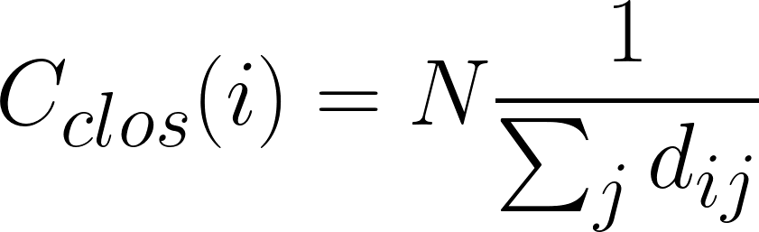
Centrality Beyond Degree: Closeness (C_{Clos})
C_{clos}(i) = 19 X 1/(4 + 3 + 2 + 3 + 3 + 3 + 2 + 1+ 1 + 2 + 2 + 2+ 1 + 2 + 1 + 3 + 2 + 4)
s
e
q
b
g
p
m
d
l
a
h
i
j
f
k
n
o
c
r

Slide 39
Centrality Beyond Degree: Closeness (C_{Clos})
C_{clos}(i) = 19 X 1/(4 + 3 + 2 + 3 + 3 + 3 + 2 + 1+ 1 + 2 + 2 + 2+ 1 + 2 + 1 + 3 + 2 + 4)
s
e
q
C_{clos}(i) = 19 X 1/41
b
g
p
m
d
l
a
h
i
j
f
k
n
o
c
r

Slide 40
Centrality Beyond Degree: Closeness (C_{Clos})
C_{clos}(i) = 19 X 1/(4 + 3 + 2 + 3 + 3 + 3 + 2 + 1+ 1 + 2 + 2 + 2+ 1 + 2 + 1 + 3 + 2 + 4)
s
e
q
C_{clos}(i) = 19 X 1/41
b
C_{clos}(i) = 19 X 0.024 = 0.46
g
p
m
d
l
a
h
i
j
f
k
n
o
c
r

Slide 41
a | b | c | d | e | f | g | h | i | j | k | l | m | n | o | p | q | r | s
a | 0 | 1 | 2 | 1 | 2 | 1 | 2 | 3 | 4 | 5 | 6 | 6 | 6 | 5 | 6 | 5 | 7 | 4 | 8
b | 1 | 0 | 3 | 1 | 1 | 2 | 1 | 2 | 3 | 4 | 5 | 5 | 5 | 4 | 5 | 4 | 6 | 3 | 7
c | 2 | 3 | 0 | 2 | 3 | 1 | 2 | 1 | 2 | 3 | 4 | 4 | 4 | 3 | 4 | 3 | 5 | 2 | 6
d | 1 | 1 | 2 | 0 | 1 | 1 | 1 | 2 | 3 | 4 | 5 | 5 | 5 | 4 | 5 | 4 | 6 | 3 | 7
e | 2 | 1 | 3 | 1 | 0 | 2 | 1 | 2 | 3 | 4 | 5 | 5 | 5 | 4 | 5 | 4 | 6 | 3 | 7
f | 1 | 2 | 1 | 1 | 2 | 0 | 1 | 2 | 3 | 4 | 5 | 5 | 5 | 4 | 5 | 4 | 6 | 3 | 7
g | 2 | 1 | 2 | 1 | 1 | 1 | 0 | 1 | 2 | 3 | 4 | 4 | 4 | 3 | 4 | 3 | 5 | 2 | 6
h | 3 | 2 | 1 | 2 | 2 | 2 | 1 | 0 | 1 | 2 | 3 | 3 | 3 | 2 | 3 | 2 | 4 | 1 | 5
i | 4 | 3 | 2 | 3 | 3 | 3 | 2 | 1 | 0 | 1 | 2 | 2 | 2 | 1 | 2 | 1 | 3 | 2 | 4
j | 5 | 4 | 3 | 4 | 4 | 4 | 3 | 2 | 1 | 0 | 1 | 1 | 1 | 1 | 1 | 1 | 2 | 3 | 3
k | 6 | 5 | 4 | 5 | 5 | 5 | 4 | 3 | 2 | 1 | 0 | 1 | 2 | 2 | 2 | 1 | 3 | 4 | 4
l | 6 | 5 | 4 | 5 | 5 | 5 | 4 | 3 | 2 | 1 | 1 | 0 | 1 | 2 | 2 | 2 | 2 | 4 | 3
m | 6 | 5 | 4 | 5 | 5 | 5 | 4 | 3 | 2 | 1 | 2 | 1 | 0 | 2 | 2 | 2 | 1 | 4 | 2
n | 5 | 4 | 3 | 4 | 4 | 4 | 3 | 2 | 1 | 1 | 2 | 2 | 2 | 0 | 1 | 2 | 3 | 3 | 4
o | 6 | 5 | 4 | 5 | 5 | 5 | 4 | 3 | 2 | 1 | 2 | 2 | 2 | 1 | 0 | 2 | 3 | 4 | 4
p | 5 | 4 | 3 | 4 | 4 | 4 | 3 | 2 | 1 | 1 | 1 | 2 | 2 | 2 | 2 | 0 | 3 | 3 | 4
q | 7 | 6 | 5 | 6 | 6 | 6 | 5 | 4 | 3 | 2 | 3 | 2 | 1 | 3 | 3 | 3 | 0 | 5 | 1
r | 4 | 3 | 2 | 3 | 3 | 3 | 2 | 1 | 2 | 3 | 4 | 4 | 4 | 3 | 4 | 3 | 5 | 0 | 6
s | 8 | 7 | 6 | 7 | 7 | 7 | 6 | 5 | 4 | 3 | 4 | 3 | 2 | 4 | 4 | 4 | 1 | 6 | 0

Slide 42
In this graph, this node has the smallest closeness centrality!
a | b | c | d | e | f | g | h | i | j | k | l | m | n | o | p | q | r | s
a | 0 | 1 | 2 | 1 | 2 | 1 | 2 | 3 | 4 | 5 | 6 | 6 | 6 | 5 | 6 | 5 | 7 | 4 | 8
b | 1 | 0 | 3 | 1 | 1 | 2 | 1 | 2 | 3 | 4 | 5 | 5 | 5 | 4 | 5 | 4 | 6 | 3 | 7
c | 2 | 3 | 0 | 2 | 3 | 1 | 2 | 1 | 2 | 3 | 4 | 4 | 4 | 3 | 4 | 3 | 5 | 2 | 6
d | 1 | 1 | 2 | 0 | 1 | 1 | 1 | 2 | 3 | 4 | 5 | 5 | 5 | 4 | 5 | 4 | 6 | 3 | 7
e | 2 | 1 | 3 | 1 | 0 | 2 | 1 | 2 | 3 | 4 | 5 | 5 | 5 | 4 | 5 | 4 | 6 | 3 | 7
f | 1 | 2 | 1 | 1 | 2 | 0 | 1 | 2 | 3 | 4 | 5 | 5 | 5 | 4 | 5 | 4 | 6 | 3 | 7
g | 2 | 1 | 2 | 1 | 1 | 1 | 0 | 1 | 2 | 3 | 4 | 4 | 4 | 3 | 4 | 3 | 5 | 2 | 6
h | 3 | 2 | 1 | 2 | 2 | 2 | 1 | 0 | 1 | 2 | 3 | 3 | 3 | 2 | 3 | 2 | 4 | 1 | 5
i | 4 | 3 | 2 | 3 | 3 | 3 | 2 | 1 | 0 | 1 | 2 | 2 | 2 | 1 | 2 | 1 | 3 | 2 | 4
j | 5 | 4 | 3 | 4 | 4 | 4 | 3 | 2 | 1 | 0 | 1 | 1 | 1 | 1 | 1 | 1 | 2 | 3 | 3
k | 6 | 5 | 4 | 5 | 5 | 5 | 4 | 3 | 2 | 1 | 0 | 1 | 2 | 2 | 2 | 1 | 3 | 4 | 4
l | 6 | 5 | 4 | 5 | 5 | 5 | 4 | 3 | 2 | 1 | 1 | 0 | 1 | 2 | 2 | 2 | 2 | 4 | 3
m | 6 | 5 | 4 | 5 | 5 | 5 | 4 | 3 | 2 | 1 | 2 | 1 | 0 | 2 | 2 | 2 | 1 | 4 | 2
n | 5 | 4 | 3 | 4 | 4 | 4 | 3 | 2 | 1 | 1 | 2 | 2 | 2 | 0 | 1 | 2 | 3 | 3 | 4
o | 6 | 5 | 4 | 5 | 5 | 5 | 4 | 3 | 2 | 1 | 2 | 2 | 2 | 1 | 0 | 2 | 3 | 4 | 4
p | 5 | 4 | 3 | 4 | 4 | 4 | 3 | 2 | 1 | 1 | 1 | 2 | 2 | 2 | 2 | 0 | 3 | 3 | 4
q | 7 | 6 | 5 | 6 | 6 | 6 | 5 | 4 | 3 | 2 | 3 | 2 | 1 | 3 | 3 | 3 | 0 | 5 | 1
r | 4 | 3 | 2 | 3 | 3 | 3 | 2 | 1 | 2 | 3 | 4 | 4 | 4 | 3 | 4 | 3 | 5 | 0 | 6
s | 8 | 7 | 6 | 7 | 7 | 7 | 6 | 5 | 4 | 3 | 4 | 3 | 2 | 4 | 4 | 4 | 1 | 6 | 0

Slide 43
Centrality Beyond Degree: Closeness (C_{Clos})
Node s is far away from most other nodes!
s
e
q
b
g
p
m
d
l
a
h
i
j
f
k
n
o
c
r

Slide 44
a | b | c | d | e | f | g | h | i | j | k | l | m | n | o | p | q | r | s
0.26 | 0.31 | 0.35 | 0.32 | 0.3 | 0.31 | 0.39 | 0.45 | 0.46 | 0.43 | 0.32 | 0.33 | 0.34 | 0.38 | 0.32 | 0.38 | 0.27 | 0.32 | 0.22
s
e
q
b
g
p
m
d
l
a
h
i
j
f
k
n
o
c
r

Slide 45
Centrality Beyond Degree: Betweenness (C_{Bet})
A node that is in the middle of the largest number of shortest paths indirectly connecting the other pairs of nodes in the graph has the largest betweenness centrality!
s
e
q
b
g
p
m
d
l
a
h
i
j
f
k
n
o
c
r

Slide 46
Centrality Beyond Degree: Betweenness (C_{Bet})
In this graph, this node has the largest betweenness centrality!
s
e
q
b
g
p
m
d
l
a
h
i
j
f
k
n
o
c
r

Slide 47
Centrality Beyond Degree: Betweenness (C_{Bet})
This is the shortest path between g and i: and h is in the middle of it!
s
e
q
b
g
p
m
d
l
a
h
i
j
f
k
n
o
c
r

Slide 48
Centrality Beyond Degree: Betweenness (C_{Bet})
This is the shortest path between p and c: and h is in the middle of it!
s
e
q
b
g
p
m
d
l
a
h
i
j
f
k
n
o
c
r

Slide 49
Centrality Beyond Degree: Betweenness (C_{Bet})
This is the shortest path between k and r: and h is in the middle of it!
s
e
q
b
g
p
m
d
l
a
h
i
j
f
k
n
o
c
r

Slide 50
Centrality Beyond Degree: Betweenness (C_{Bet})
You can see that h has to be high betweenness because they stand on the shortest paths indirectly connecting the nodes on the left with the nodes on the right
s
e
q
b
g
p
m
d
l
a
h
i
j
f
k
n
o
c
r

Slide 51
Centrality Beyond Degree: Betweenness (C_{Bet})
You can see that h has to be high betweenness because they stand on the shortest paths indirectly connecting the nodes on the right with the nodes on the left
s
e
q
b
g
p
m
d
l
a
h
i
j
f
k
n
o
c
r

Slide 52
Centrality Beyond Degree: Betweenness (C_{Bet})
You can see that h has to be high betweenness because they stand on the shortest paths indirectly connecting the nodes on the right with the nodes on the left
s
e
q
b
g
p
m
d
l
a
h
i
j
f
k
n
o
c
r

Slide 53
Centrality Beyond Degree: Betweenness (C_{Bet})
This node is probably also high-betweenness but not as high as h!
s
e
q
b
g
p
m
d
l
a
h
i
j
f
k
n
o
c
r

Slide 54
a | b | c | d | e | f | g | h | i | j | k | l | m | n | o | p | q | r | s
0.6 | 3.8 | 9 | 5.2 | 0 | 10.2 | 53 | 88.1 | 81.5 | 66.5 | 0.5 | 1.5 | 32 | 5 | 0 | 5 | 17 | 0 | 0
Indeed!
s
e
q
b
g
p
m
d
l
a
h
i
j
f
k
n
o
c
r

Slide 55
The star graph
In the star graph three centralities are maximized for the central node
Node a has the highest:
c
b
d
i
a
e
h
f
g

Slide 56
The star graph
In the star graph three centralities are maximized for the central node
Node a has the highest:
  Degree centrality
    Every other node has C_{deg} = 1 but the central node has C_{deg} = N - 1!
c
b
d
i
a
e
h
f
g

Slide 57
The star graph
In the star graph three centralities are maximized for the central node
Node a has the highest:
  Degree centrality
    Every other node has C_{deg} = 1 but the central node has C_{deg} = N - 1!
  Closeness centrality
    Can reach all nodes via paths of length 1!
c
b
d
i
a
e
h
f
g

Slide 58
The star graph
In the star graph three centralities are maximized for the central node
Node a has the highest:
  Degree centrality
    Every other node has C_{deg} = 1 but the central node has C_{deg} = N - 1!
  Closeness centrality
    Can reach all nodes via paths of length 1!
  Betweenness centrality
    The central node stands in every one of the shortest paths linking all the other pairs of nodes (length = 2)!
c
b
d
i
a
e
h
f
g

Slide 59
Centrality Beyond Degree: Eigenvector (C_{Eig})
A node that is directly and indirectly connected to other nodes of high degree has the highest eigenvector centrality!
s
e
q
b
g
p
m
d
l
a
h
i
j
f
k
n
o
c
r

Slide 60
Centrality Beyond Degree: Eigenvector (C_{Eig})
In this graph, this node has the highest eigenvector centrality!
s
e
q
b
g
p
m
d
l
a
h
i
j
f
k
n
o
c
r

Slide 61
Centrality Beyond Degree: Eigenvector (C_{Eig})
C_{deg}(e) = 3
Node d is directly connected to other nodes that have high degree centrality (for this graph)
s
C_{deg}(b) = 4
e
q
b
g
C_{deg}(g) = 5
p
m
d
l
a
h
i
j
f
k
C_{deg}(a) = 3
C_{deg}(f) = 4
n
o
c
r

Slide 62
Centrality Beyond Degree: Eigenvector (C_{Eig})
Node d is also indirectly connected to other high-degree nodes via relatively short paths
s
e
q
b
g
p
C_{deg}(j) = 7
m
d
l
a
h
i
j
f
k
n
o
c
r

Slide 63
Centrality Beyond Degree: Eigenvector (C_{Eig})
It is called “eigenvector” because it is calculated using a matrix algebra called eigenvalue decomposition to rank each node according to whether they are connected to well-connected others.
s
e
q
b
g
p
C_{deg}(j) = 7
m
d
l
a
h
i
j
f
k
n
o
c
r

Slide 64
Centrality Beyond Degree: Eigenvector (C_{Eig})
Eigenvector centrality was discovered by a Professor of sociology at UCLA! (Bonacich 1978)
s
e
q
b
g
p
C_{deg}(j) = 7
m
d
l
a
h
i
j
f
k
n
o
c
r

Slide 65
a | b | c | d | e | f | g | h | i | j | k | l | m | n | o | p | q | r | s
12.6 | 16.1 | 5.7 | 19 | 13.6 | 14.1 | 18.1 | 8 | 5.7 | 6.6 | 3.5 | 3.3 | 2.7 | 3.8 | 2.7 | 4 | 0.7 | 2.1 | 0.2
Eigenvector centrality was discovered by a Professor of sociology at UCLA! (Bonacich 1978)
s
e
q
b
g
p
C_{deg}(j) = 7
m
d
l
a
h
i
j
f
k
n
o
c
r

Slide 66
Types of centrality measures and interpretations
How well is a node directly connected to others?
  Degree, indegree, outdegree: Based on the number of one-step connections from that node to all others
How well is a node indirectly connected to others?
  Closeness: Based on the number shortest paths that begin with that node and reach the others
How well can a node serve as an intermediary between other nodes?
  Betweenness: Based on the proportion of shortest paths between all other pairs of nodes including that node
How well is node connected to highly connected others?
  Eigenvector: Based on the direct and indirect connections of that node to other central nodes

Slide 67
Graph Centralization

Slide 68
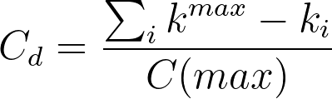
Graph Centralization
Degree Centralization compares an observed network to one that is maximally centralized (the star graph of the same order)
A
A
E
B
C
E
B
C
D
D
A | B | C | D | E
4 - 1 | 4 - 4 | 4 - 1 | 4 -1 | 4 - 1
3 | 0 | 3 | 3 | 3
k^{max} =4
A | B | C | D | E
4 - 3 | 4 - 4 | 4 - 3 | 4 -3 | 4 - 3
1 | 0 | 1 | 1 | 1
k^{max} =4
Maximally Centralized Network (N = 5)
Observed Network
(N = 5)

Slide 69
Graph Centralization
It is given by the sum of the differences between maximum degree and the degree of each node in the observed network to the same number in the star graph of the same size
A
A
E
B
C
E
B
C
D
D
A | B | C | D | E
4 - 1 | 4 - 4 | 4 - 1 | 4 -1 | 4 - 1
3 | 0 | 3 | 3 | 3
k^{max} =4
Sum of differences: 12
A | B | C | D | E
4 - 3 | 4 - 4 | 4 - 3 | 4 -3 | 4 - 3
1 | 0 | 1 | 1 | 1
k^{max} =4
Sum of differences: 4
Maximally Centralized Network (N = 5)
Observed Network
(N = 5)

Slide 70
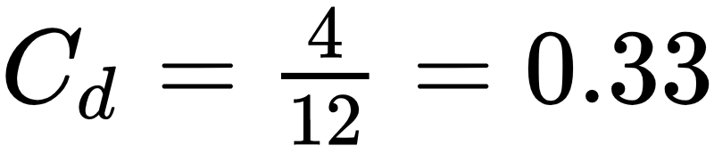
Graph Centralization
It is given by the sum of the differences between maximum degree and the degree of each node in the observed network to the same number in the star graph of the same size
A
A
E
B
C
E
B
C
D
D
A | B | C | D | E
4 - 1 | 4 - 4 | 4 - 1 | 4 -1 | 4 - 1
3 | 0 | 3 | 3 | 3
k^{max} =4
Sum of differences: 12
(n-1)*(n-2)
A | B | C | D | E
4 - 3 | 4 - 4 | 4 - 3 | 4 -3 | 4 - 3
1 | 0 | 1 | 1 | 1
k^{max} =4
Sum of differences: 4
Maximally Centralized Network (N = 5)
Observed Network
(N = 5)

Slide 71
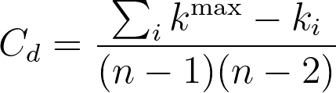
Graph Centralization
It is given by the sum of the differences between maximum degree and the degree of each node in the observed network to the same number in the star graph of the same size
A
A
E
B
C
E
B
C
D
D
A | B | C | D | E
4 - 1 | 4 - 4 | 4 - 1 | 4 -1 | 4 - 1
3 | 0 | 3 | 3 | 3
k^{max} =4
Sum of differences: 12
(n-1)*(n-2)
A | B | C | D | E
4 - 3 | 4 - 4 | 4 - 3 | 4 -3 | 4 - 3
1 | 0 | 1 | 1 | 1
k^{max} =4
Sum of differences: 4
Maximally Centralized Network (N = 5)
Observed Network
(N = 5)

Slide 72
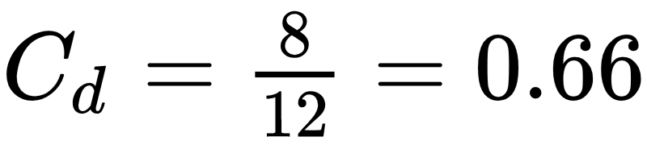
Graph Centralization
The closest the graph centralization is to 1.0 the closer the observed graph is to the star graph
A
A
E
B
C
E
B
C
D
D
A | B | C | D | E
4 - 1 | 4 - 4 | 4 - 1 | 4 -1 | 4 - 1
3 | 0 | 3 | 3 | 3
k^{max} =4
Sum of differences: 12
(n-1)*(n-2)
A | B | C | D | E
4 - 2 | 4 - 4 | 4 - 2 | 4 -2 | 4 - 2
2 | 0 | 2 | 2 | 2
k^{max} =4
Sum of differences: 8
Maximally Centralized Network (N = 5)
Observed Network
(N = 5)

Slide 73
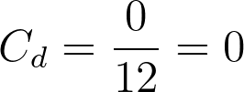
Graph Centralization
The opposite of the star graph is the regular graph. Everyone has the same degree and centralization is zero!
A
A
E
B
C
E
B
C
D
D
A | B | C | D | E
4 - 1 | 4 - 4 | 4 - 1 | 4 -1 | 4 - 1
3 | 0 | 3 | 3 | 3
k^{max} =4
Sum of differences: 12
(n-1)*(n-2)
A | B | C | D | E
4 - 4 | 4 - 4 | 4 - 4 | 4 - 4 | 4 - 4
0 | 0 | 0 | 0 | 0
k^{max} =4
Sum of differences: 0
Maximally Centralized Network (N = 5)
Observed Network
(N = 5)

